Slide 1
Lending club case study
Analysis by
-Ranjith Kumar J
-Sakshi Singh

Slide 2
Agenda
Problem Statement
Data Understanding
Data Cleaning and Manipulation
Data Analysis
Univariate Analysis
Bivariate Analysis
Multivariate Analysis
Correlation Matrix
Conclusions & Recommendations
References & links

Slide 3
Problem Statement LEnding Club is a consumer finance marketplace that connects borrowers seeking personal loans with investors looking to lend money for a return. It specializes in providing various types of loans to customers. When the company receives a loan application, it must decide whether to approve the loan based on the applicant's profile. Like most lending companies, lending to 'risky' applicants is the largest source of financial loss, known as credit loss. Credit loss occurs when the lender loses money because the borrower refuses to pay or absconds with the money owed. In other words, borrowers who default cause the most significant loss to the lenders. In this context, customers labeled as 'charged-off' are considered 'defaulters'.

Slide 4
Data Cleaning & Manipulation
Read CSV file
Identify & drop-off duplicate Rows & Columns
Identify & drop-off Rows & Columns with Null,NAN,NA,0 values
Identify & drop-off descriptive and identification columns(unique fields)
Identify if any derived columns are necessary
Conversion of data to the appropriate data types
Processing for outlier data
Imputing values in Columns

Slide 5
Data Understanding The data provided in the data set loan.csv contains information about past loan applicants and whether they defaulted. The goal is to identify patterns that indicate if a person is likely to default. This information can be used to make decisions such as denying the loan, reducing the loan amount, or lending to risky applicants at a higher interest rate. Leading Attribute Loan Accepted - Three Scenarios Fully Paid - Applicant has fully paid the loan (the principal and the interest rate) Current - Applicant is in the process of paying the instalments, i.e. the tenure of the loan is not yet completed. These candidates are not labelled as 'defaulted’. Charged-off - Applicant has not paid the instalments in due time for a long period of time, i.e. he/she has defaulted on the loan Loan Rejected - The company had rejected the loan (because the candidate does not meet their requirements etc.). Since the loan was rejected, there is no transactional history of those applicants with the company and so this data is not available with the company (and thus in this dataset)

Slide 6
Data Cleaning and Manipulation Data Processing using EDA Rows & Columns Analysis Find and drop off columns which are of same value throughout the entire rows Find number of rows which has loan status as Current which means the loan installment is still in progress and drop such rows Certain column data doesnt add value to data analysis hence can be dropped Dropping columns with majority(ie 50%) of rows being the NULL values which doesnt help in Data Analysis Data Imputing for revol_util and emp_length columns which are blank with median, mean values respectively Data Type Conversion

Slide 7
Univariate Analysis
Categorical variables
Quantitative variables

Slide 8
Univariate Analysis
Categorical Variables:
Ordered | Unordered
Grade (grade) Sub grade (sub_grade) Term (36 / 60 months) (term) Employment length (emp_length) | Loan purpose (purpose) Home Ownership (home_ownership) Loan status (loan_status) Loan paid (loan_paid)
Quantitative Variables:
Debt to Income Ratio (DTI) bucket (dti_bucket)
Interest rate bucket (int_rate_bucket)Annual income bucket (annual_inc_bucket)
Loan amount bucket (loan_amnt_bucket)
Funded amount bucket (funded_amnt_bucket)
Monthly Installment (installment)

Slide 9
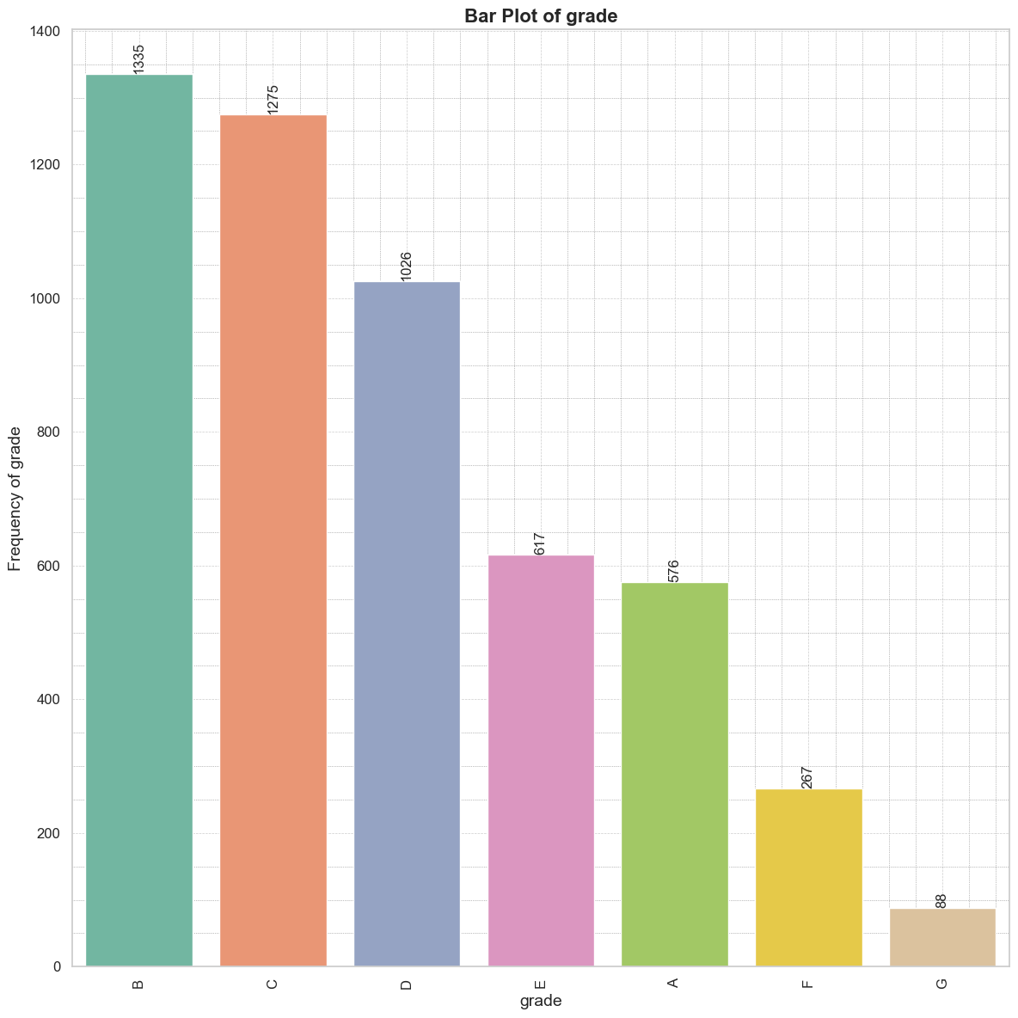
Bar plot for grade
Grade: Grade B has the most "Charged off" loan applicants (1,335), indicating the highest default risk. Grade G has the fewest (88), indicating the lowest default risk

Slide 10
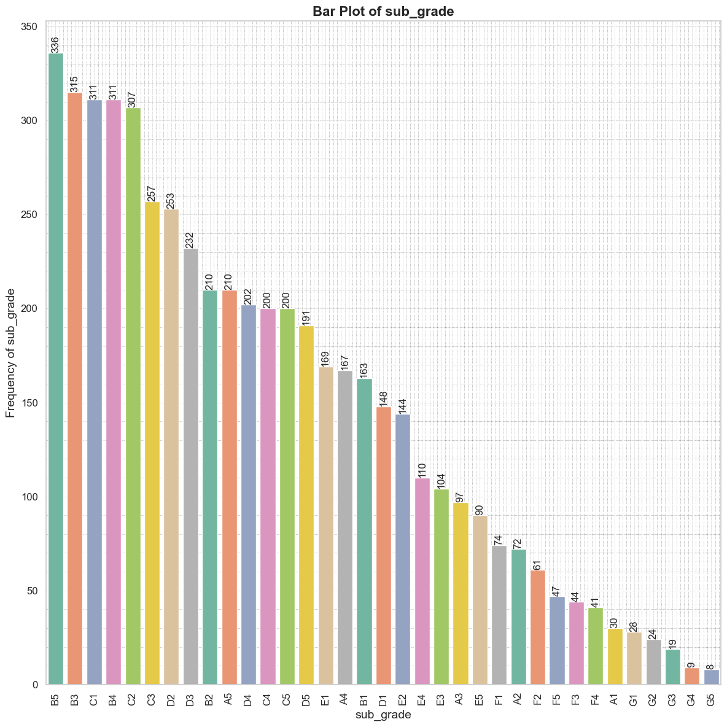
Bar plot for sub_grade
Sub-Grade: Within Grade B, B5 shows the highest default risk, while G5 shows the lowest

Slide 11
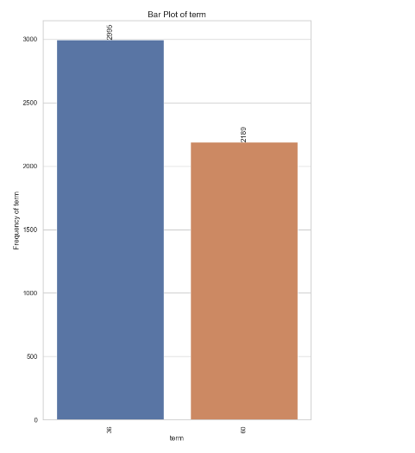
Bar plot of term TErm: Loans with a 36-month term had the highest number of defaults (2,995), suggesting shorter terms are associated with higher default rates.

Slide 12
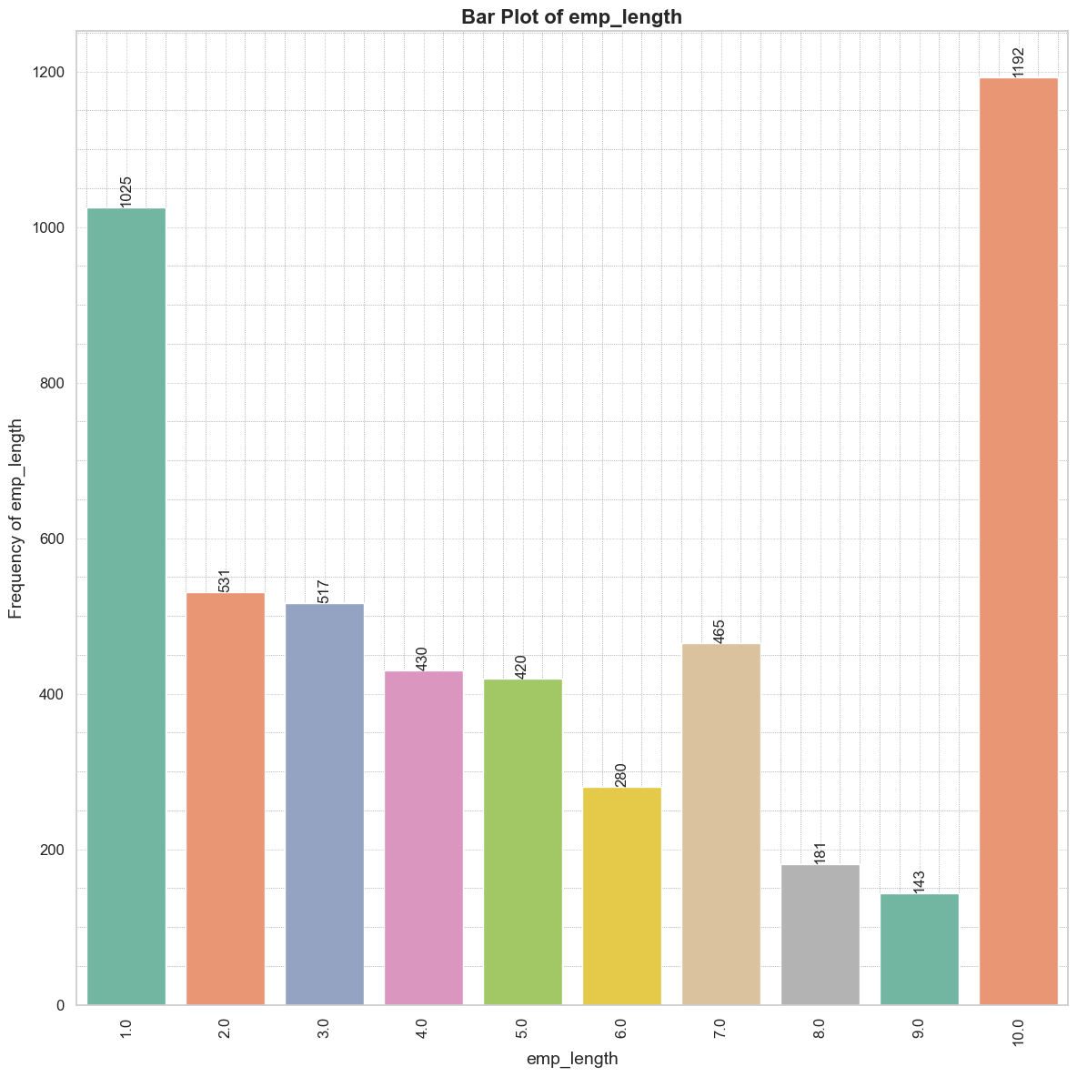
Bar plot of emp_length Employment Term: Applicants employed for over 10 years had the most defaults (1,192), indicating long-term employment does not guarantee repayment success.

Slide 13
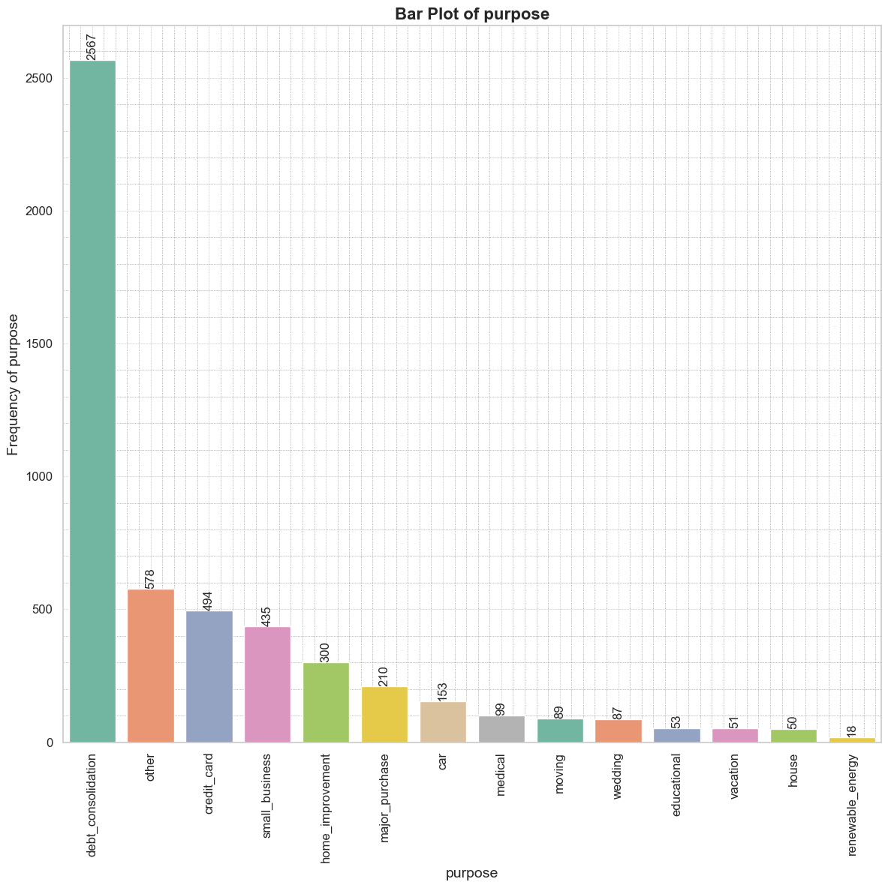
Bar plot of purpose Purpose: Debt consolidation was the top reason for default (2,567 applicants). The lending company should be cautious with these loans, as they are often used to pay off other debts.

Slide 14
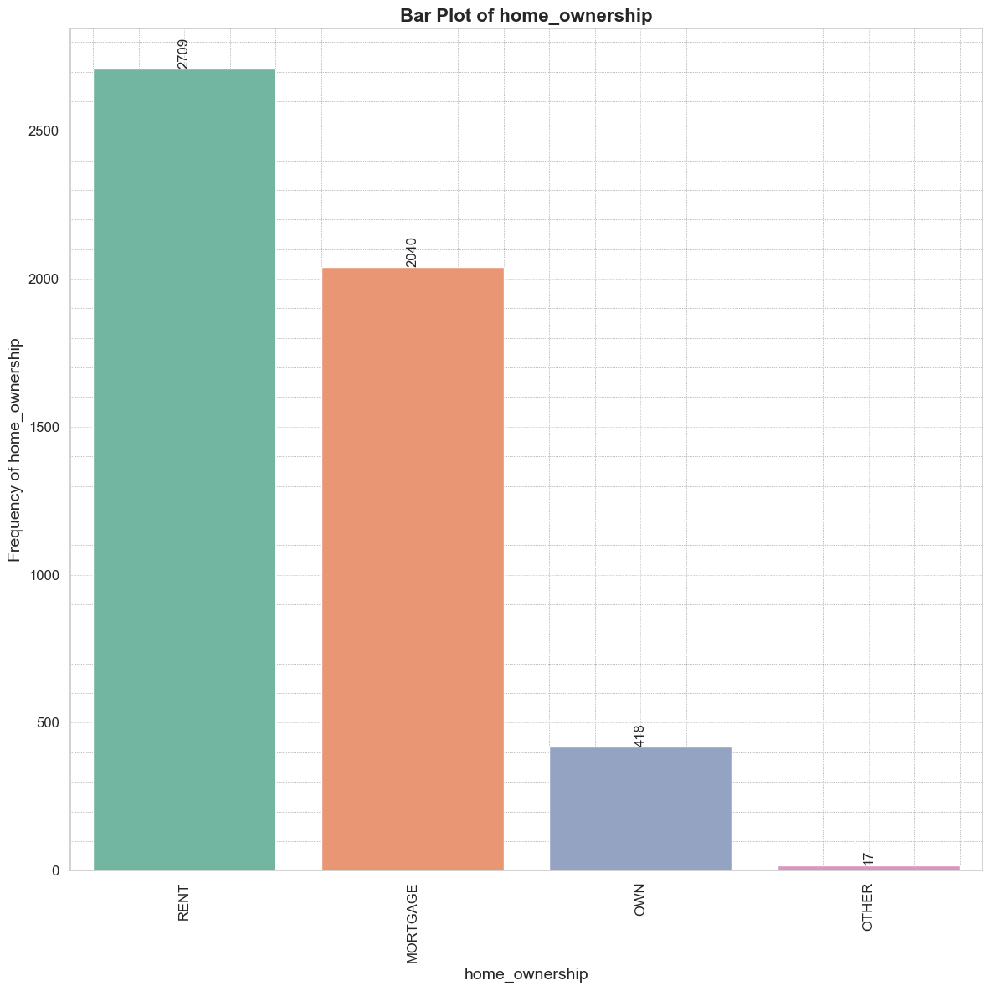
Bar plot of home_ownership Home Ownership: Most defaults were from applicants in rented homes (2,709). The lending company should assess the financial stability of renters, who may be more vulnerable to economic changes.

Slide 15
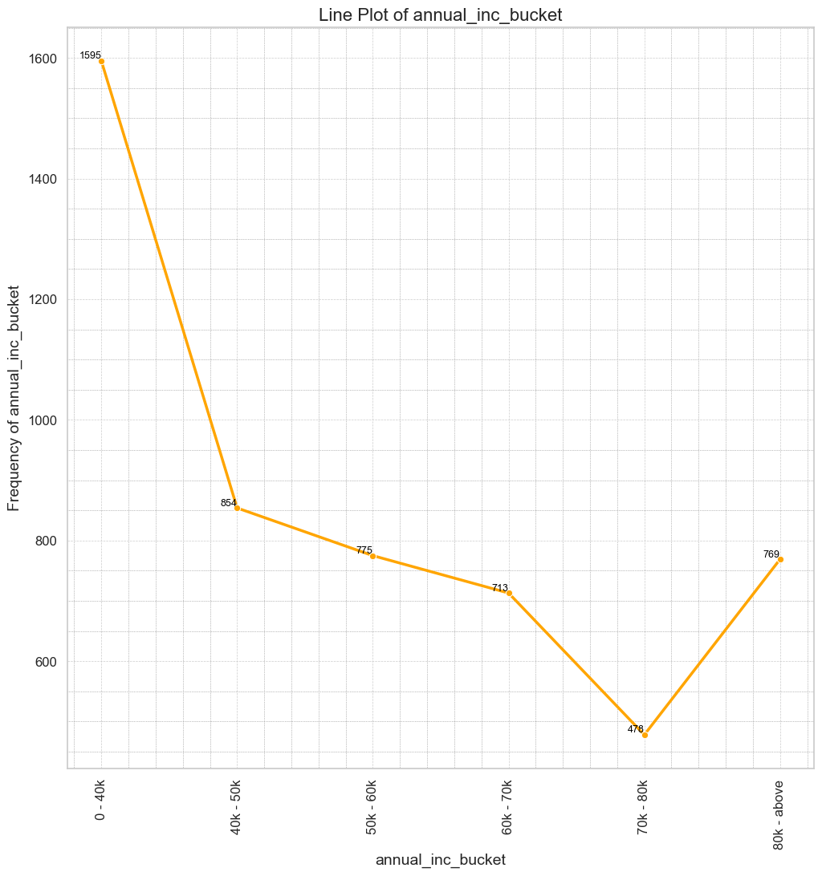
Line plot of annual_inc_bucket Annual Income: 1,595 defaults were from applicants earning less than $40,000 annually. The company should scrutinize low-income applicants more closely, verifying income and repayment capacity thoroughly.

Slide 16
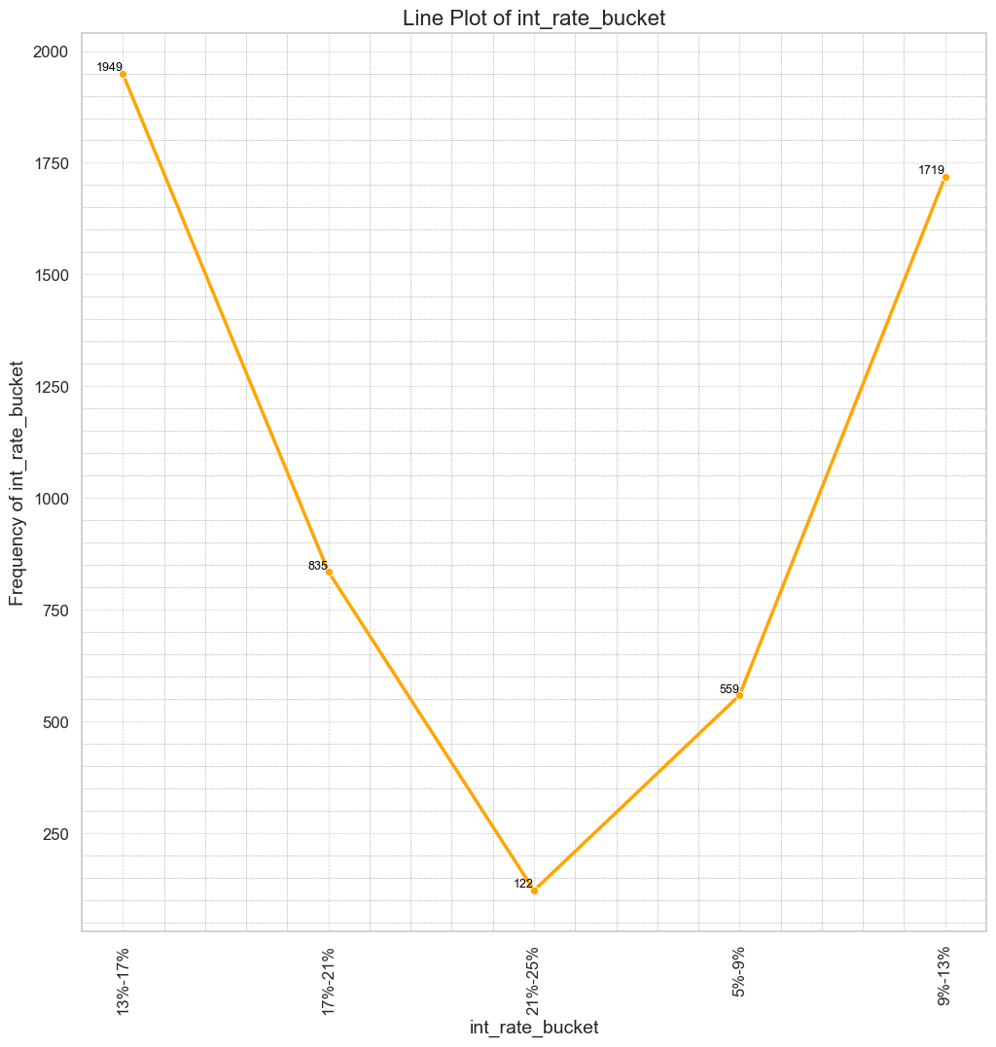
Line plot of int_rate_bucket Interest Rates: A significant number of defaults (1,949) occurred with interest rates between 13%-17%. The company should consider offering lower rates to mitigate default risk.

Slide 17
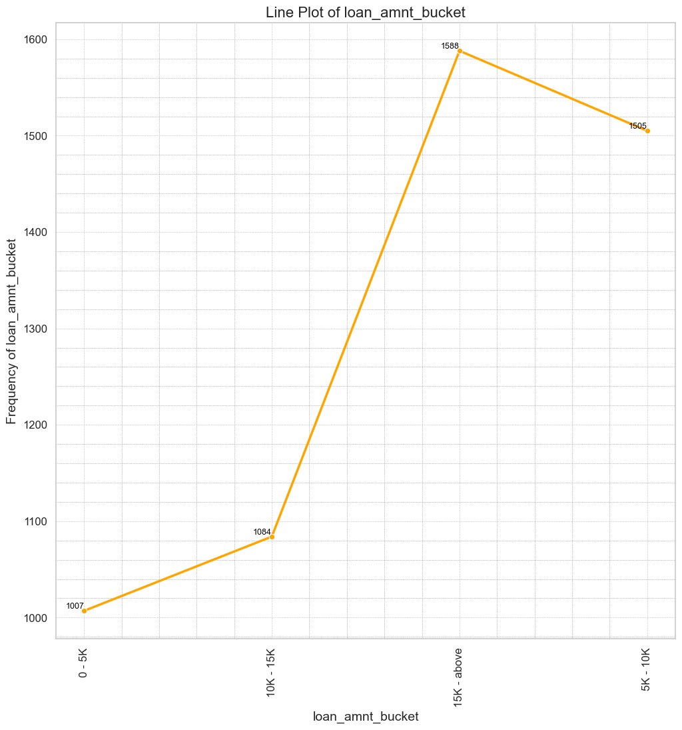
line plot of loan_amnt_bucket Loan Amount: 1,588 defaults involved loans of $15,000 or more. High loan amounts should be granted only to applicants with strong credit histories and repayment capabilities.

Slide 18
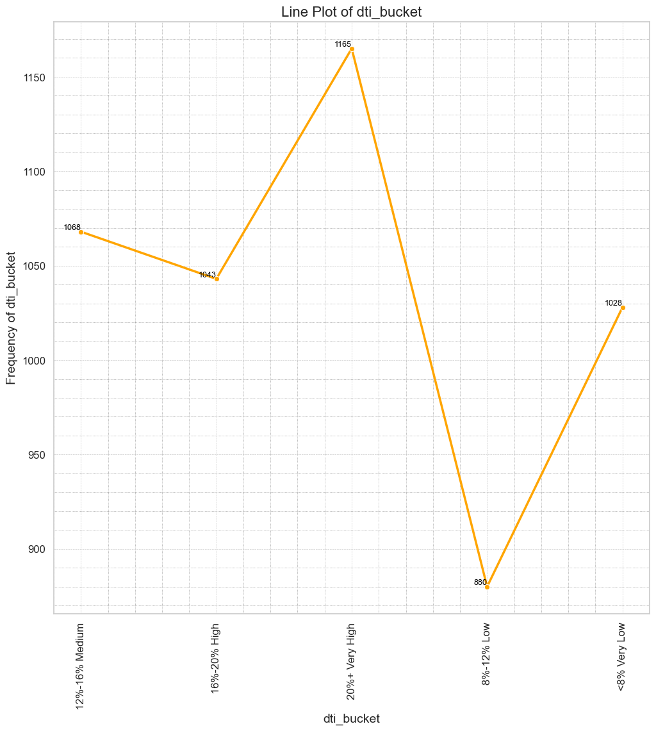
Line plot of dti_bucket Debt-to-Income Ratio: 1,165 defaults were from applicants with high debt-to-income ratios. Strict ratio requirements should be enforced to prevent lending to over-indebted individuals.

Slide 19
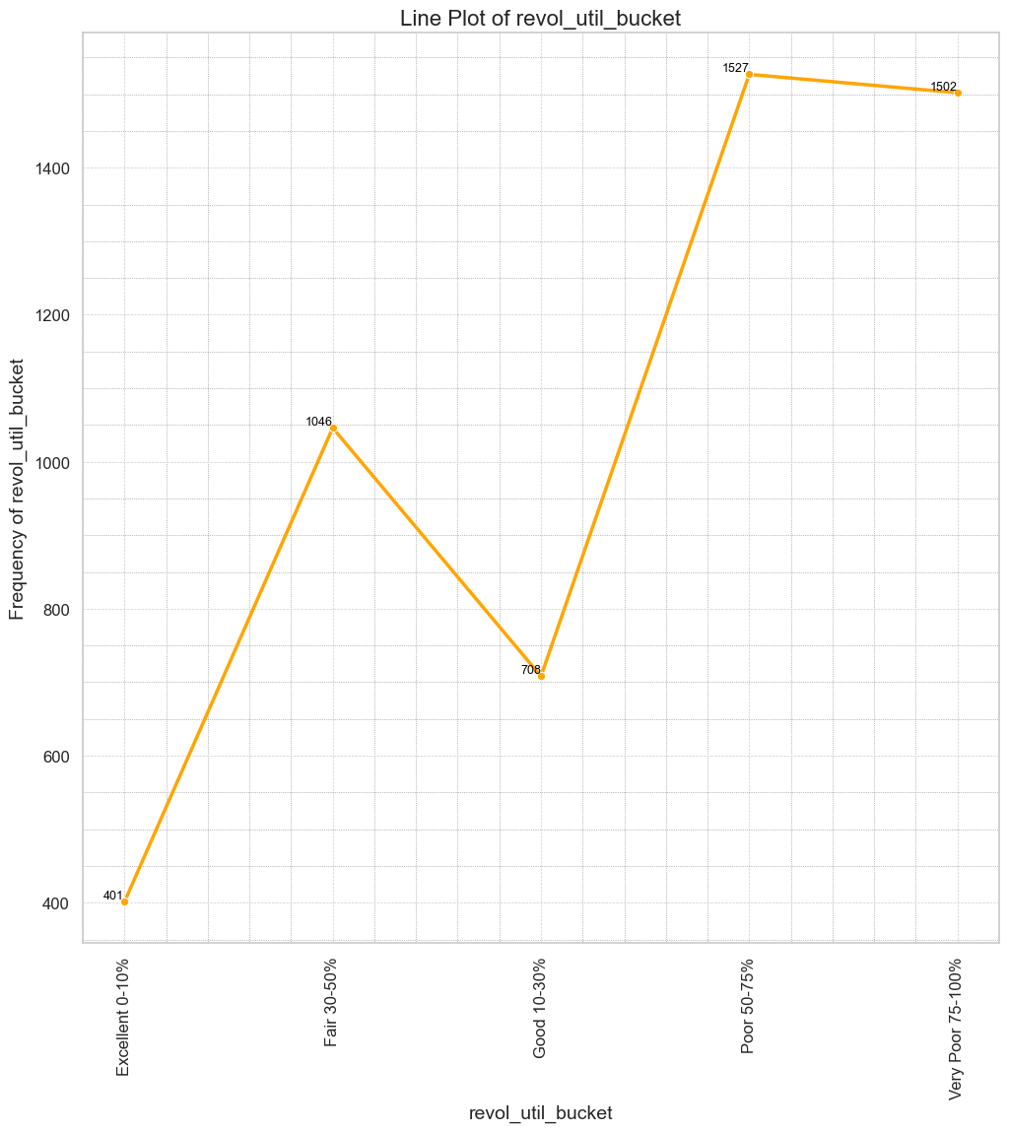
Line plot for revol_util_bucket Revolving Line Utilization Rate (RLUR): Defaults were highest among those with Poor (50%-75%) and Very Poor (75%-100%) RLUR, at 1,527 and 1,502 respectively. RLUR should be a key consideration in lending decisions to gauge credit utilizations to gauge credit utilization.

Slide 20
Bivariate Analysis
For Bivariate Analysis, Loan_Status is considered as one variable, representing Fully_Paid and Charged_Off states.
The Default Rate or Charged_Off percentage is considered as the second variable against various other parameters such as grade, sub_grade, emp_length, purpose, home_ownership, and verification_status.

Slide 21
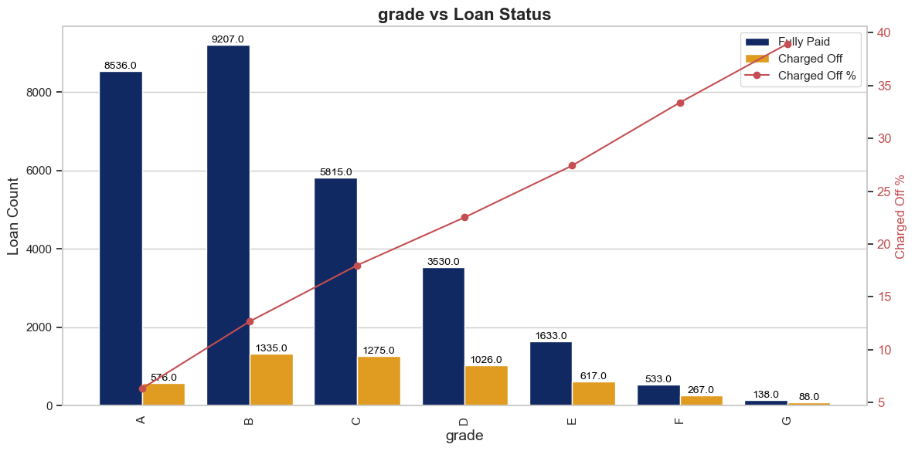
Grade and Loan status Grade B has a high number of default applicants (1335), whereas in relative numbers, Grade G has 38% of applicants defaulting.

Slide 22
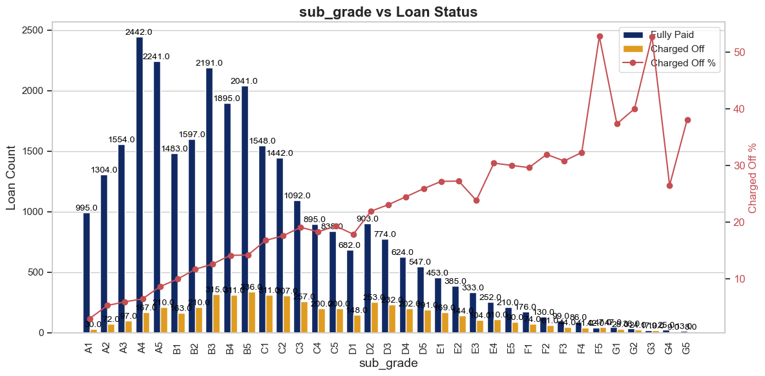
Sub_grade and loan_status Subgrades B3, B4, and B5 as they are more likely to charge off in absolute numbers. Also, note subgrades F3 and G3, where the default rate is more than 50%.

Slide 23
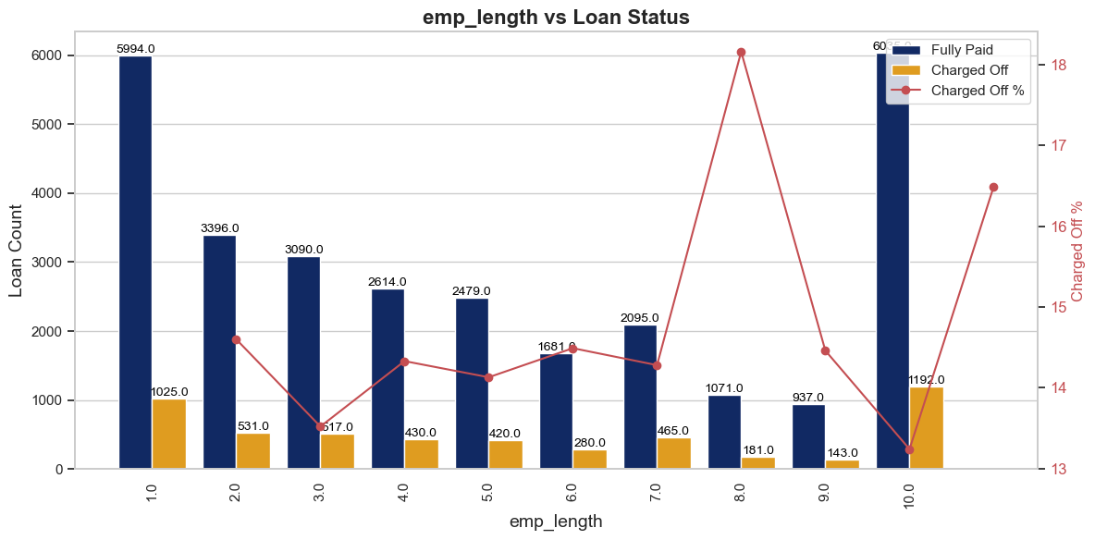
Emp_length and loan status Loan applicants with ten or more years of experience are more likely to default in absolute numbers, whereas in relative numbers, applicants with 8 years of experience have an 18% default rate.

Slide 24
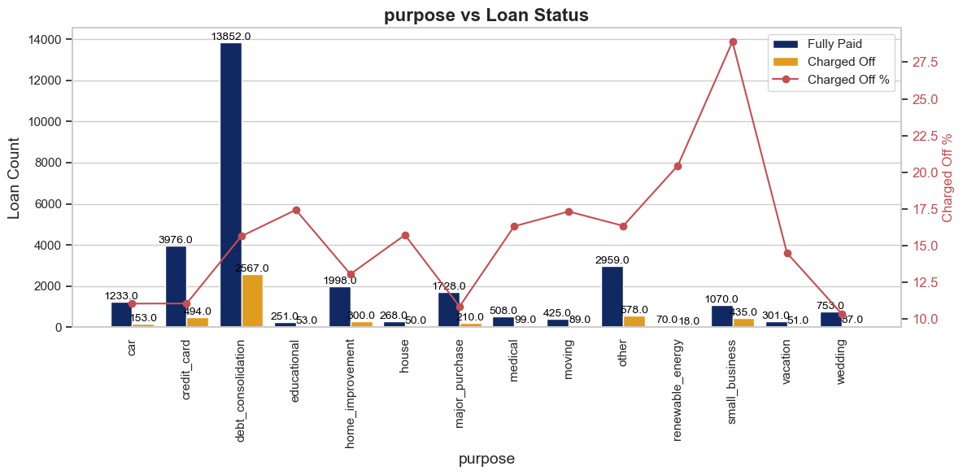
Purpose and loan status Applicants seeking loans for debt consolidation are high in absolute terms, which may result in a vicious debt cycle if financial discipline isn't followed. In relative terms, loans taken for small businesses have a higher percentage of defaults.

Slide 25
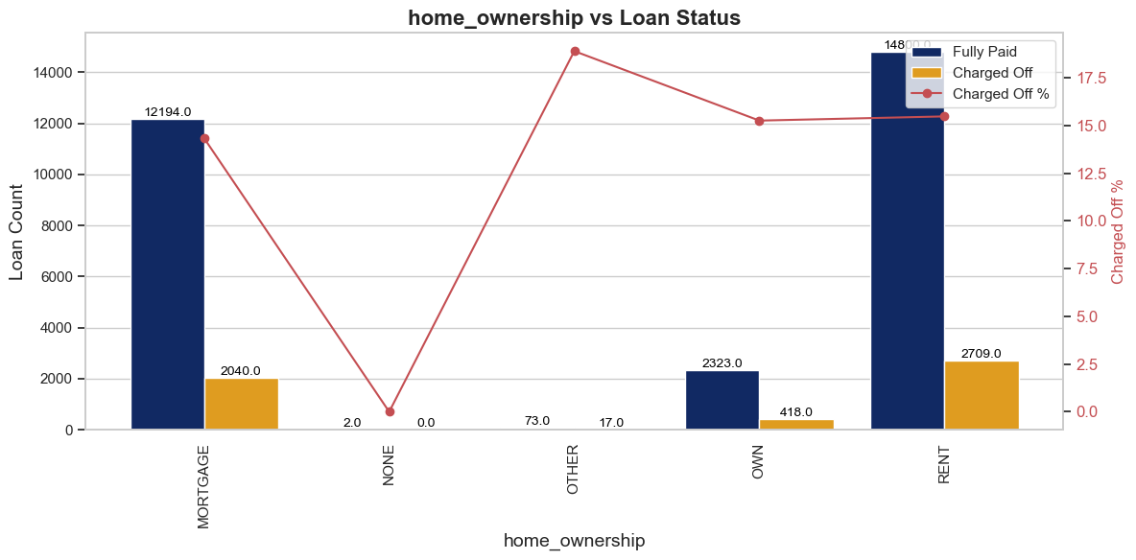
Home ownership and loan status This category doesn't provide much inference since most of the ownership types in relative terms have a 15-17% default rate

Slide 26
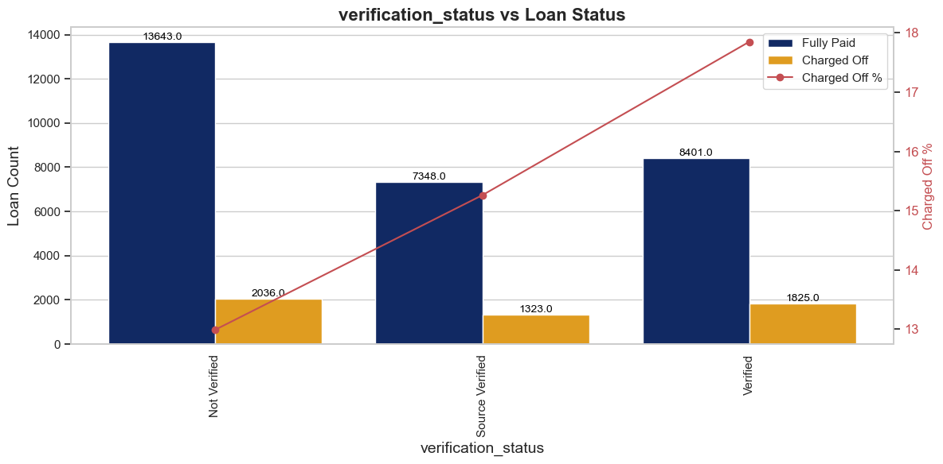
Verification status and loan status Verified loan applicants are defaulting more than those who are not verified.

Slide 27
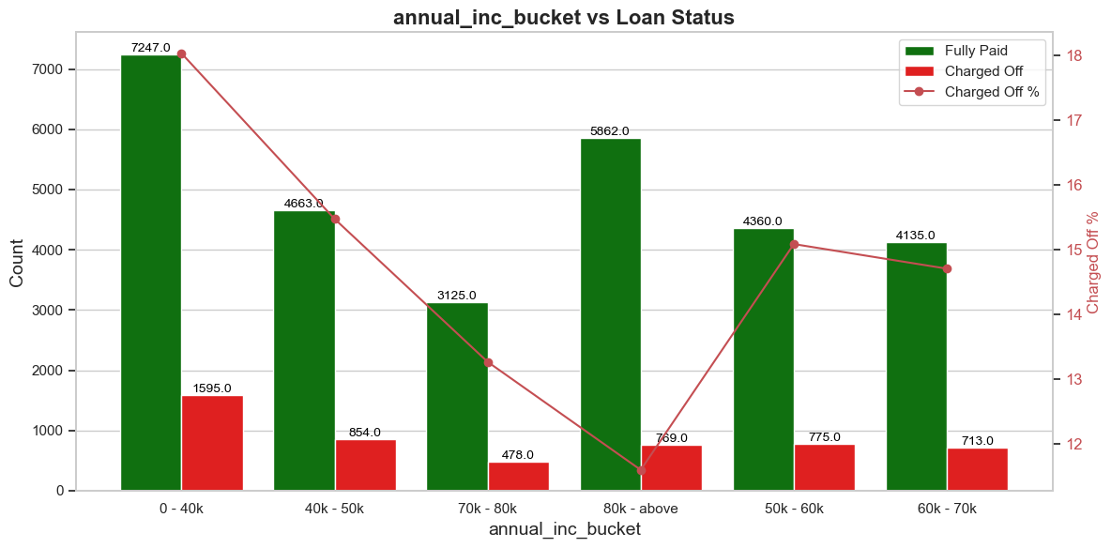
Annual_inc_bucket and loan status Applicants with annual incomes less than $40,000 have a higher likelihood of defaulting both in absolute and relative terms.

Slide 28
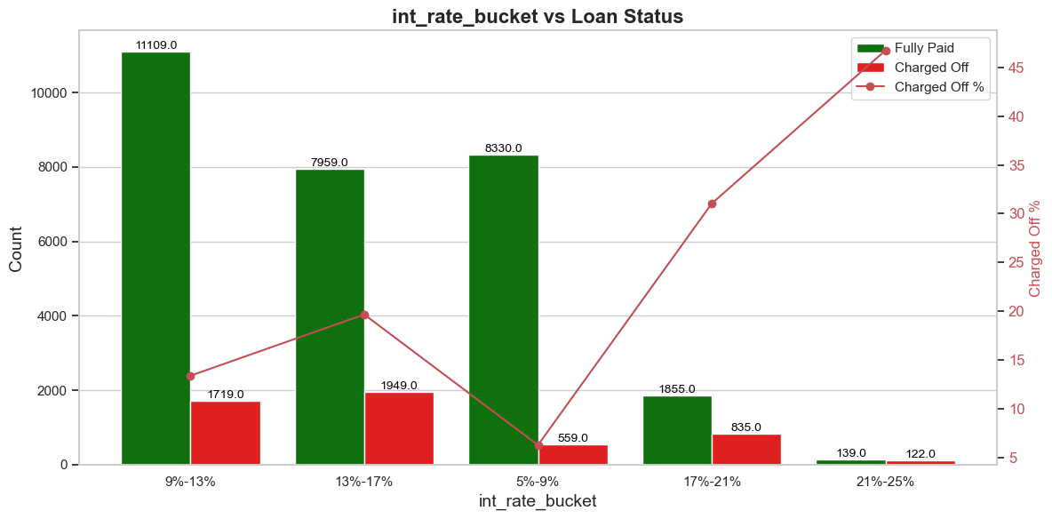
Int_rate_bucket and loan_status Interest rates in the 13%-17% range are associated with defaults in absolute terms, whereas the default possibility is high in the high-interest rate bucket of 21-25% in relative terms.

Slide 29
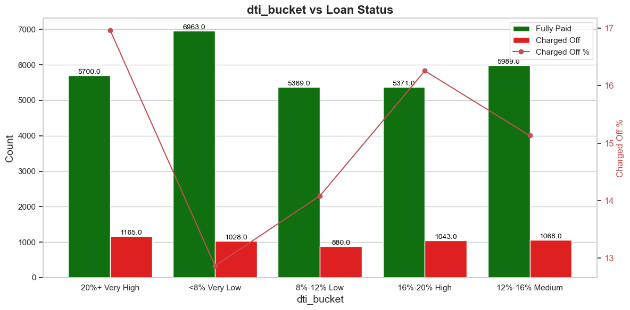
Dti_bucket and loan status Applicants with a high DTI ratio (>20%) have a higher likelihood of defaulting both in absolute and relative terms. Hence, this should be a strong criterion for the lending company.

Slide 30
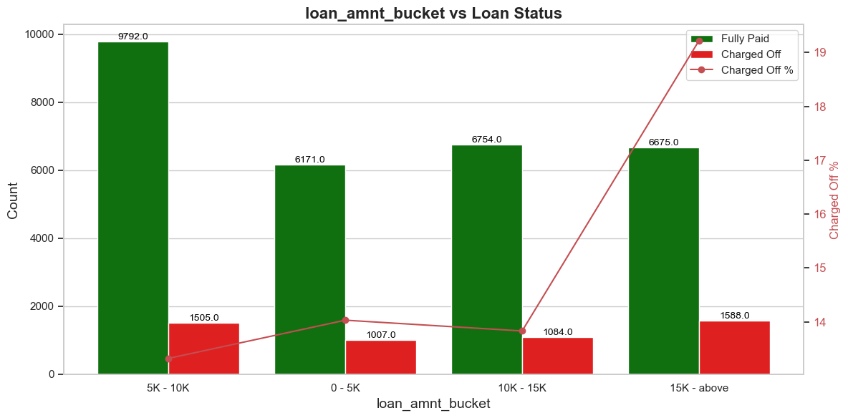
Loan_amnt_bucket and loan status Applicants receiving loan amounts of $15,000 or higher are more likely to default.

Slide 31
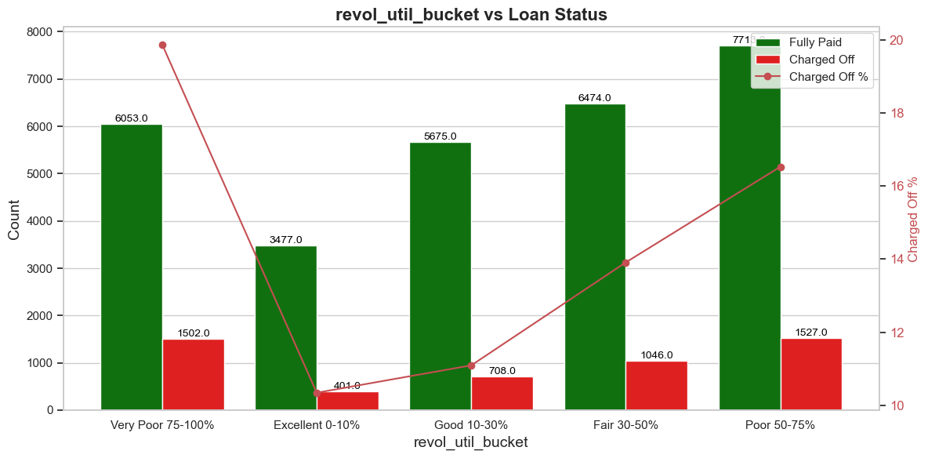
Revol_util_bucket and loan status Applicants with poor (50-75%) RLUR are highly likely to default in absolute terms, whereas very poor (75-100%) RLUR applicants are highly likely to default in relative terms.

Slide 32
Correlation Analysis

Slide 33
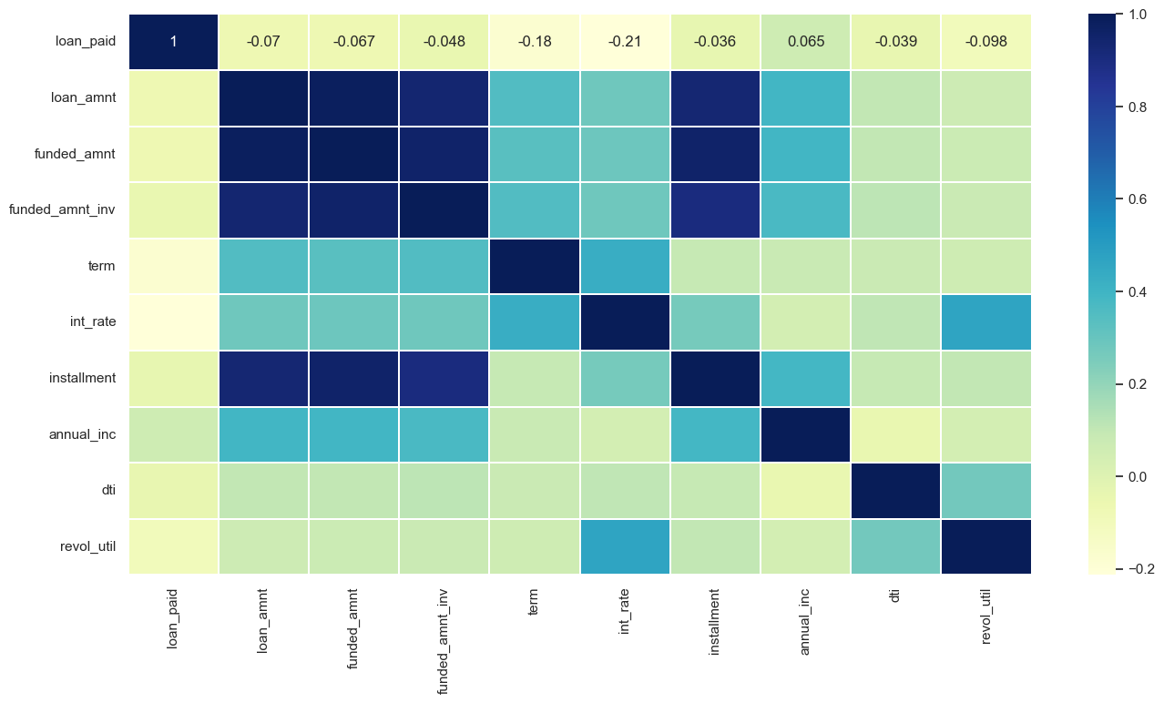
loan_amnt shows a strong correlation with funded_amnt, int_rate, and funded_amnt_inv. Term is strongly correlated with the interest rate.

Slide 34
Correlation Analysis Summary Strong Correlation loan_amnt shows a strong correlation with funded_amnt, int_rate, and funded_amnt_inv. term is strongly correlated with the interest rate. Weak Correlation loan_paid exhibits weak correlations with most variables. emp_length has weak correlations with most variables. Negative Correlation int_rate has a negative correlation with loan_paid.

Slide 35

Conclusion
Univariate Analysis Summary : Grade,Term,Purpose,Annual_Income,Interest_Rates,Debt-Income Ratio and Revolving Line Utilization Ratio are major variable which causes default in absolute numbers
Bivariate Analysis Summary : Annual_Income,Debt-Income Ratio and Revolving Line Utilization Ratio are major variables which could result in loan default in absolute and relative terms
Correlation Analysis Summary : loan Amount shows a strong correlation with Funded Amount, Interest Rate, and Funded Amount Investers.
Loan term is strongly correlated with the interest rate.
loan paid and employment length exhibits weak correlations with most variables.

Slide 36
THANK YOU
Sakshi Singh
Ranjith Kumar

